Slide 1
Forecasting Analytics

Slide 2
Need for forecasting
Why forecast, when you would know the outcome eventually?
Early knowledge is the key, even if that knowledge is imperfect
For setting production schedules, one needs to forecast sales
For staffing of call centers, a company needs to forecast the demand for service

Slide 3
Scatter diagram
Plots one variable against another
One of the simplest tools for visualization
Cost | Age
859 | 8
682 | 5
471 | 3
708 | 9
1094 | 11
224 | 2
320 | 1
651 | 8
1049 | 12
Example: Maintenance cost and Age for nine buses (Spokane Transit)
This is an example of cross-sectional data (observations collected in a single point of time)

Slide 4
Scatter plot

Slide 5
Time plot
Plots a variable against time index
Appropriate for visualizing serially collected data (time series)
Brings out many useful aspects of the structure of the data
Example: Electrical usage for Washington Water Power (Quarterly data from 1980 to 1991)

Slide 6
Time plot

Slide 7
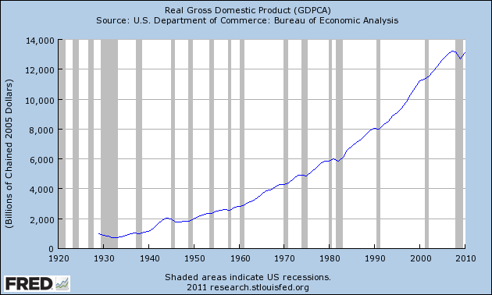
Few More Time series Plots
Annual GDP of USA

Slide 8
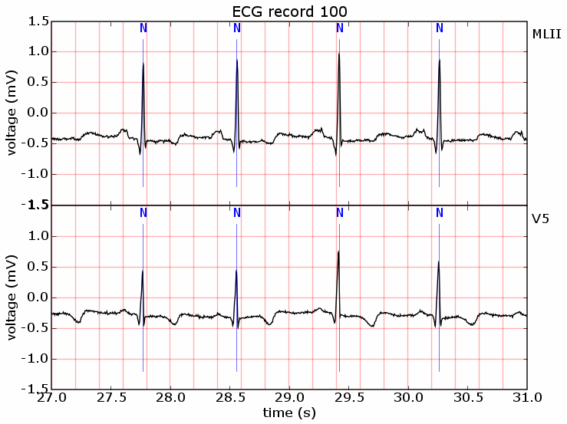
Continuous time series are obtained when observations are made continuously over some time intervals. (ECG graph).

Slide 9
Time series data (Number of sunspots) showing cycles:

Slide 10
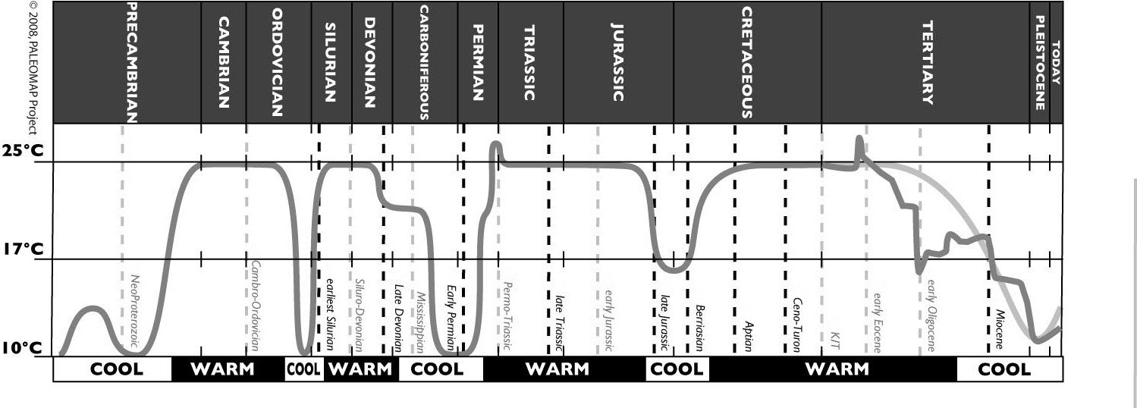
Global average temperature: Each cycle has length of few million years. Source: http://geocraft.com/WVFossils/Carboniferous_climate.html

Slide 11
BSE SENSEX (3rd Jan 2000 to 31 Dec 2012)

Slide 12

Lag plot
Plots a variable against its own lagged sample
Brings out possible association between successive samples
Example: Monthly sale of VCRs by a music store in a year
= Number of VCRs sold in time period t
= Number of VCRs sold in time period t – k

Slide 13


Example of lagged variables: Number of VCRs sold in a month
Time | Original | Lagged one step | Lagged two steps
1 | 123
2 | 130 | 123
3 | 125 | 130 | 123
4 | 138 | 125 | 130
5 | 145 | 138 | 125
6 | 142 | 145 | 138
7 | 141 | 142 | 145
8 | 146 | 141 | 142
9 | 147 | 146 | 141
10 | 157 | 147 | 146
11 | 150 | 157 | 147
12 | 160 | 150 | 157

Slide 14
Lag plot (k = 1)

Slide 15
Observations
There is a reasonable degree of association between the original variable and the lagged one.
Value of lagged variable is known beforehand, so it is useful for prediction.
Association between original and lagged variable may be quantified through a correlation.

Slide 16

Autocorrelation
Correlation between a variable and its lagged version (one time-step or more)
= Observation in time period t
= Observation in time period t – k
= Mean of the values of the series
= Autocorrelation coefficient for k-step lag

Slide 17
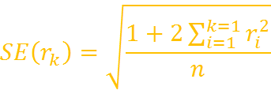

Standard error of r_{k}
The standard error is
Increases progressively with k, but eventually reaches a maximum value
If the ‘true’ autocorrelation is 0, then the estimate r_{k} should be in the interval (– 2SE(r_{k}), 2SE(r_{k})) 95% of the time.
Sometimes SE(r_{k}) is approximated by .

Slide 18
Correlogram or ACF plot
Plots the ACF or Autocorrelation function (r_{k}) against the lag (k).
Plus-and-minus two-standard errors are displayed as limits to be exceeded for statistical significance.
Reveals lagged variables that can be potentially useful for forecasting.

Slide 19
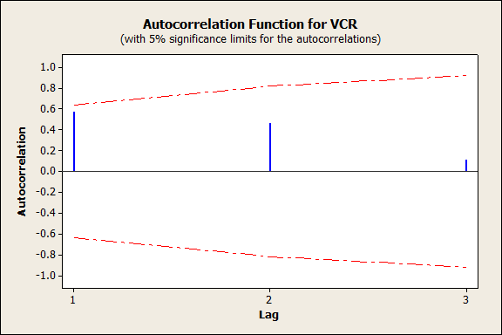
Correlogram for VCR data

Slide 20
Observations
All correlations are statistically insignificant
This could be because of small sample size

Slide 21
Thank you

